Slide 1
Inventory Level Reporting
Presented By:
Lucía Lapaz, Brittany Ersery & Jim Holsinger
Envision Technology Partners, Inc.
September 2019

Slide 2
Agenda
Inventory Management - Vaccine Reports
Vaccine Order Management Reports
VFC Program Management Reports

Slide 3
Inventory Management - Vaccine Reports

Slide 4
Count Sheet
Provides a list of current inventory items in the selected inventory location.
Users can print this report when counting their inventory before creating a new reconciliation.
Report is also available on the reconciliation page.

Slide 5
Inventory Transactions by Reconciliation Bucket
Provides a list of inventory transactions organized by reconciliation bucket for a closed reconciliation.
Useful in resolving problematic inventory items.

Slide 6
Aggregate Inventory Reconciliation
Provides information about reconciliation(s) for aggregate inventory location(s)
Detailed listing of all vaccine received, administered, wasted, etc. across all reconciliations during a specified date range
Similar to Vaccine Inventory Reconciliation Worksheet

Slide 7
Daily Vaccinations Report
Generates a list of doses administered from a specific provider’s inventory location(s)

Slide 8
Aggregate Administered Doses
Generates a list of doses administered by a clinic over a certain time period
Providers with inventory locations set to aggregate reporting should use this report when completing inventory reconciliations

Slide 9
Inventory Adjustment Inquiry
Generates a list of inventory adjustment transactions
Search criteria include:
Inventory Location
Vaccine
Funding Source
Manufacturer
Adjustment Reasons
Transaction Date Range
Available as PDF, HTML, or extract

Slide 10
Inventory On-Hand
Generates a list of Provider’s doses on-hand
Search criteria include:
Inventory Location
Vaccine
NDC
Funding Source
Manufacturer
Lot Number
Expiration Date Range
Check box to include/exclude expired vaccine
Available as PDF or extract

Slide 11
Inventory Pending Transfers
Generates a list of pending inventory transfers
Search criteria include:
Source Inventory Location
Destination Inventory Location
Vaccine
Funding Source
Manufacturer
Lot Number
Transaction Date Range
Available as PDF

Slide 12
Inventory Transaction Inquiry
Generates a list of inventory transactions
Search criteria include:
Inventory Location
Vaccine
Funding Source
Manufacturer
Lot Number
Transaction Date Range
Available as PDF, HTML, Excel, or extract

Slide 13
Inventory Transfer Inquiry
Generates a list of inventory transfers
Search criteria include:
Source Inventory Location
Destination Inventory Location
Vaccine
Funding Source
Manufacturer
Lot Number
Transaction Date Range
Available as PDF, HTML, or extract

Slide 14
Monthly Immunization Report (VFC and State)
Generates a Monthly Immunization Report (MIR) for publicly-funded vaccines belonging to a closed inventory reconciliation
Search criteria include:
Inventory Location
Reconciliation Begin Date Range
Reconciliation End Date Range

Slide 15
Possible Duplicate Inventory Report
Generates a list of inventory line items with the same lot number and stored in the same inventory location
Search criteria include:
Inventory Location
Vaccine
Funding Source
Manufacturer
Lot Number
Expiration Date Range
Edit/adjust inventory line items to resolve duplicates

Slide 16
Unaccounted for Doses
Identifies inventory transactions per inventory location with Unaccounted For adjustment reasons
Unaccounted For adjustment reasons are determined based on the "Include in the Unaccounted For Bucket Flag" on the Inventory Adjustment Reasons code table
Option to filter transactions by:
Funding Source
Vaccine Group
Multiple date ranges

Slide 17
Inventory Management - Vaccine Reports
Hands-On Exercise

Slide 18
Vaccine Order Management Reports

Slide 19
Vaccine Shipment
Generates a list of VTrckS shipments imported into WebIZ
Output includes status per line item:
Pending
Received
Dismissed
Available as PDF or extract

Slide 20
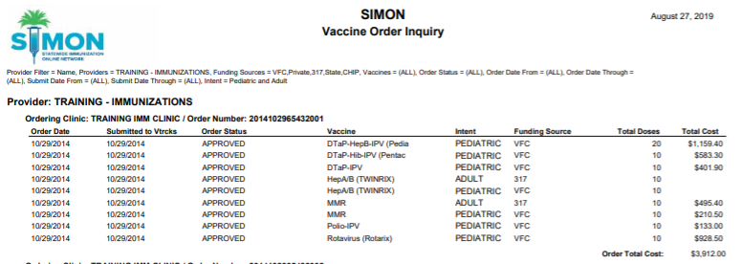
Vaccine Order Inquiry
Generates vaccine order status detail by fund type.
A summary is included at the end of the report.

Slide 21
Vaccine Order Status
View the status of VTrckS orders meeting search criteria
Available as PDF or extract

Slide 22
Vaccine Return Inquiry
Generates vaccine return status detail by fund type.
Summary includes total number of vaccines returned.

Slide 23
Vaccine Return Status
View the status of VTrckS returns meeting search criteria
Available as PDF or extract

Slide 24
Vaccine Order Management Reports
Hands-On Exercise

Slide 25
VFC Program Management Reports

Slide 26
Vaccine Program Enrollments
Generates a list of enrollment statuses for clinics based on date range.
Provides ability to track and identify clinics that need to submit a new enrollment.

Slide 27
Temp Log Aging
Generates a list of most recent approved temperature log(s) for selected VFC clinics(s)
Available as PDF or extract

Slide 28
VFC/VTrckS Site Order Configuration
Summary view of VTrckS vaccine order settings for selected provider/clinic(s), including:
VFC PIN
Assigned days of the month for ordering
Vaccine intent approval
Allowed number of doses per order
Allowed cost per order
VTrckS status
Available as PDF or extract

Slide 29
VFC/VTrckS Site Shipping Configuration
Summary view of VTrckS shipping settings for the selected provider/clinic(s), including:
VFC Contact(s)
Shipping Address
Delivery Hours
Available as PDF or extract

Slide 30
Last Closed Reconciliation
Lists the Last Reconciliation Close date for VFC Providers/Clinics with active inventory locations.
Available in Excel format.

Slide 31
Most Recent VFC Temperature Readings
This report does not have any search criteria.
Simply click Run Report to generate an Excel spreadsheet of the most recent uploaded temperature log readings for all VFC Provider/Clinic storage units and associated thermometers.

Slide 32
VFC Provider/Clinic Population
Allows VFC staff to generate a listing of the provider populations for clinics, so that they may enter the population values into VTrckS.
Available in PDF format.

Slide 33
VFC Program Management Reports
Hands-On Exercise

